Slide 2
Coffee
Jarrel Livous – Leader
Gabriel Bell – Innovator
Jeremy Jackson – Peacemaker
Latorious Spurlock - Organizer
April 24, 2018 – 11:00am – 12:20pm
Southern University and Agricultural & Mechanical College
Baton Rouge, Louisiana
Thurman Hall - Room 204

Slide 3
Genesis

Slide 4
Aim/Purpose
Our aim is to have Genesis to be used as a daily tool to help organize a person’s daily alarms and sleep schedule.

Slide 5



Platform
Genesis will be a mobile device application with the ability to be used on Apple and Android mobile devices.

Slide 6
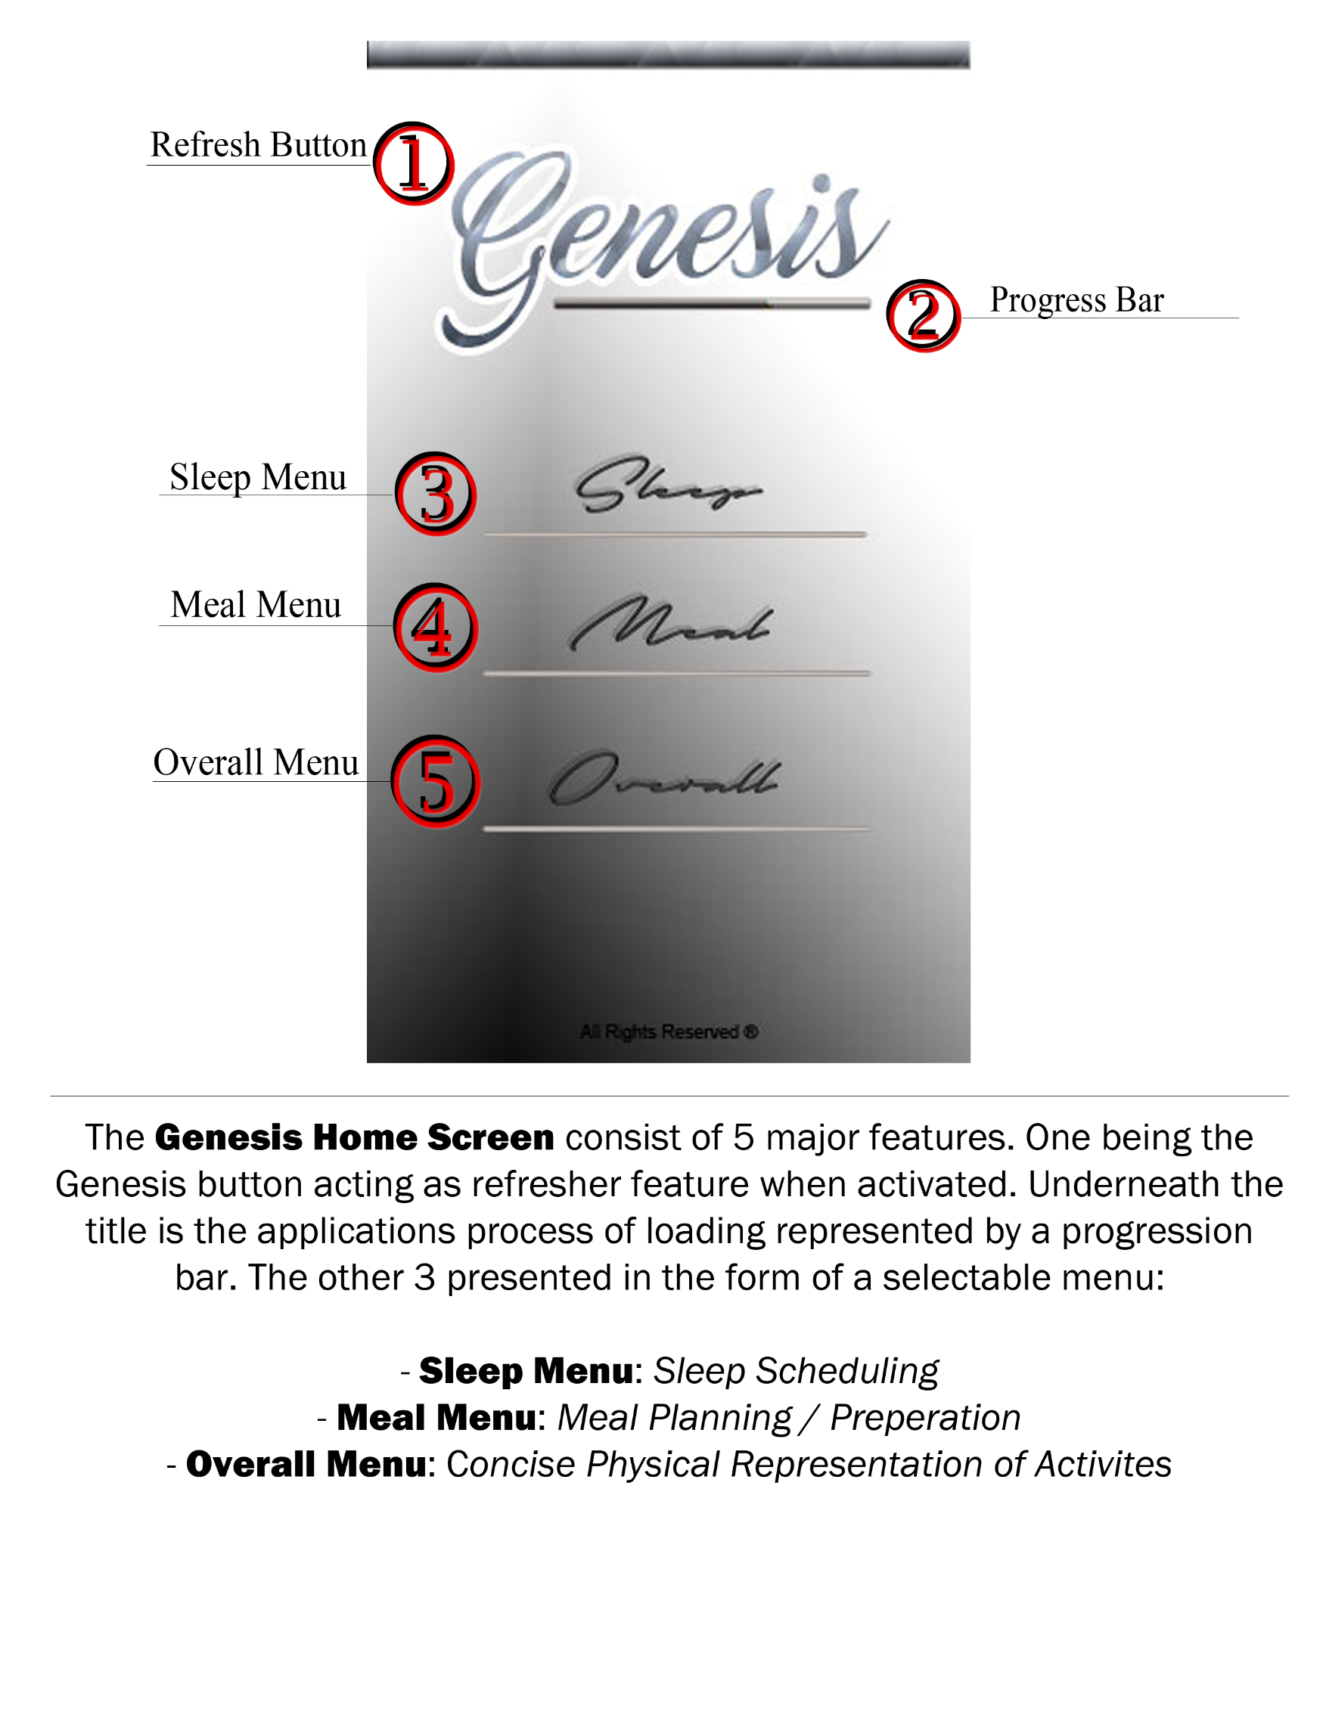

Slide 7
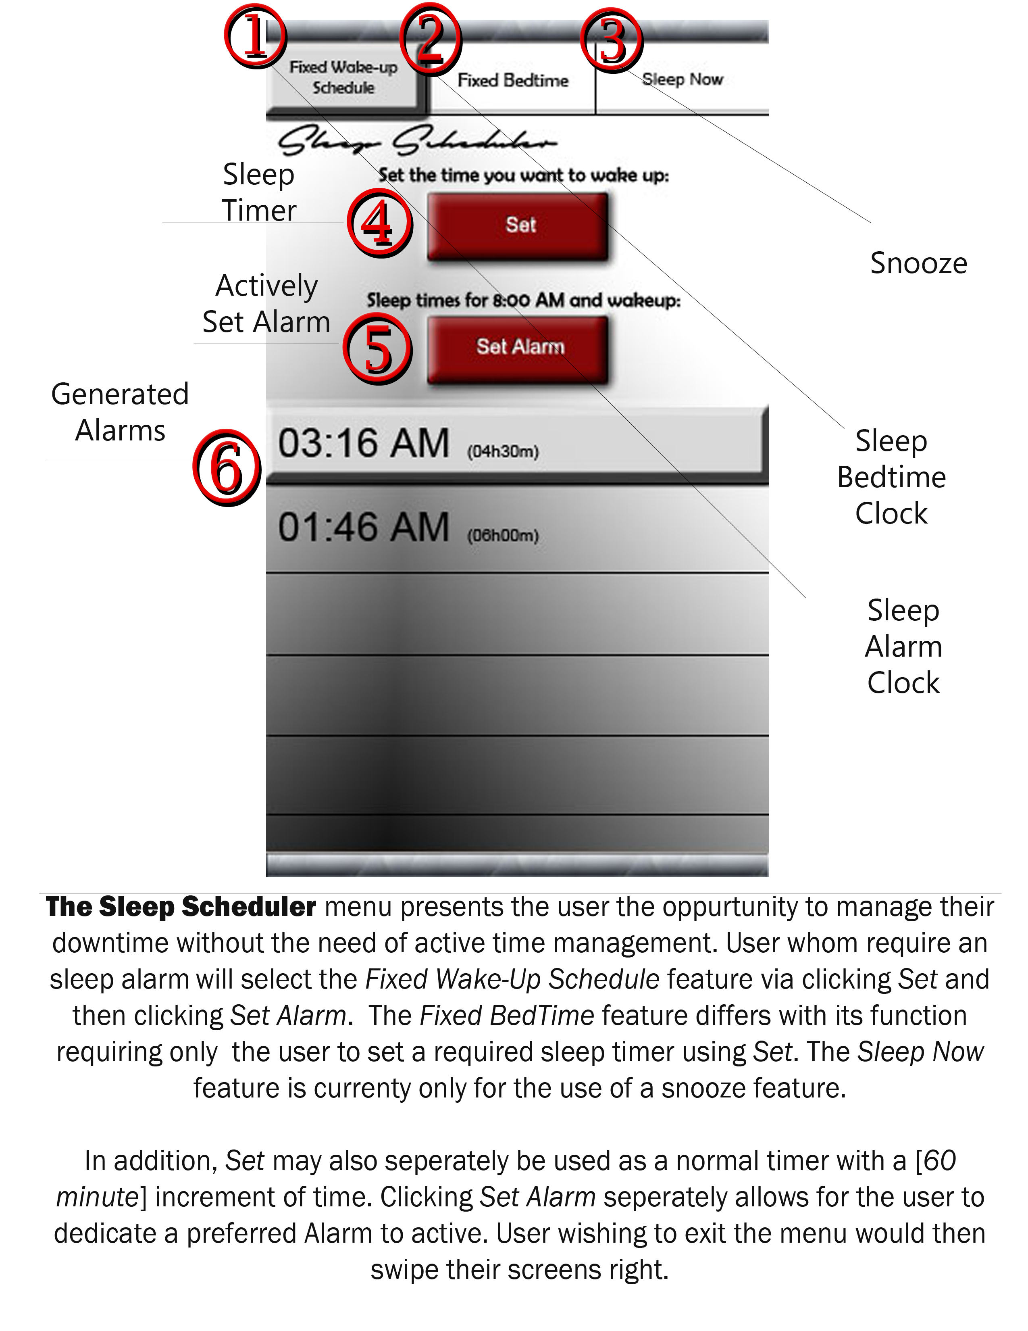

Slide 8
Limitations:
- It will send alerts and reminders
- Sleep bed times can be input and set
- Times can be set for the alarm clock timer
- Alerts will be displayed and sound off
- Snooze alerts can be set and displayed
- List of sleep alarms will be displayed

Slide 9
Delimitations:
- Plan daily activities
- Keep track of weight gain/weight loss
- Act as a calendar with events
- Track your work schedule
- Keep track of health records
- Track athletic activity

Slide 10
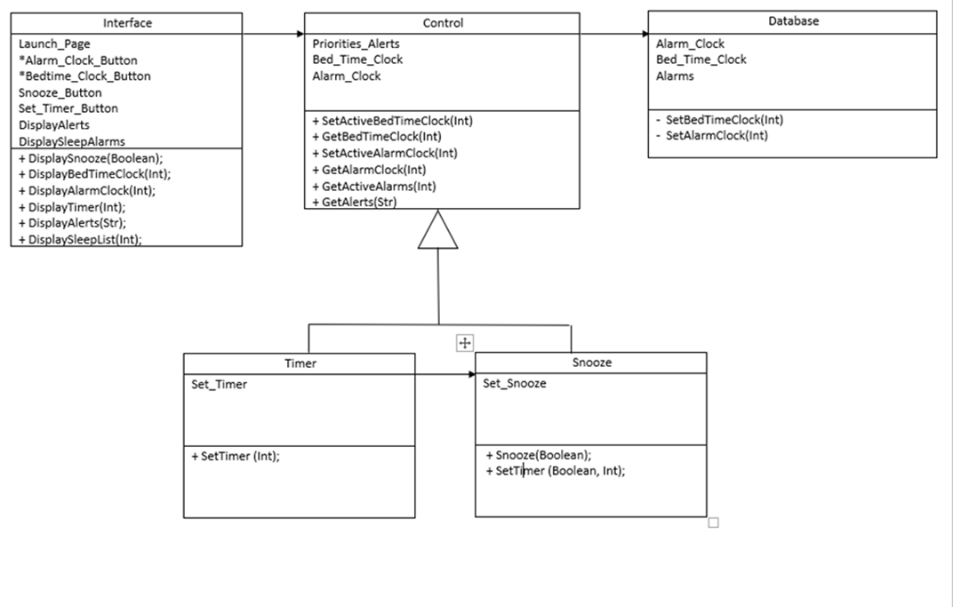
Class Diagram

Slide 11
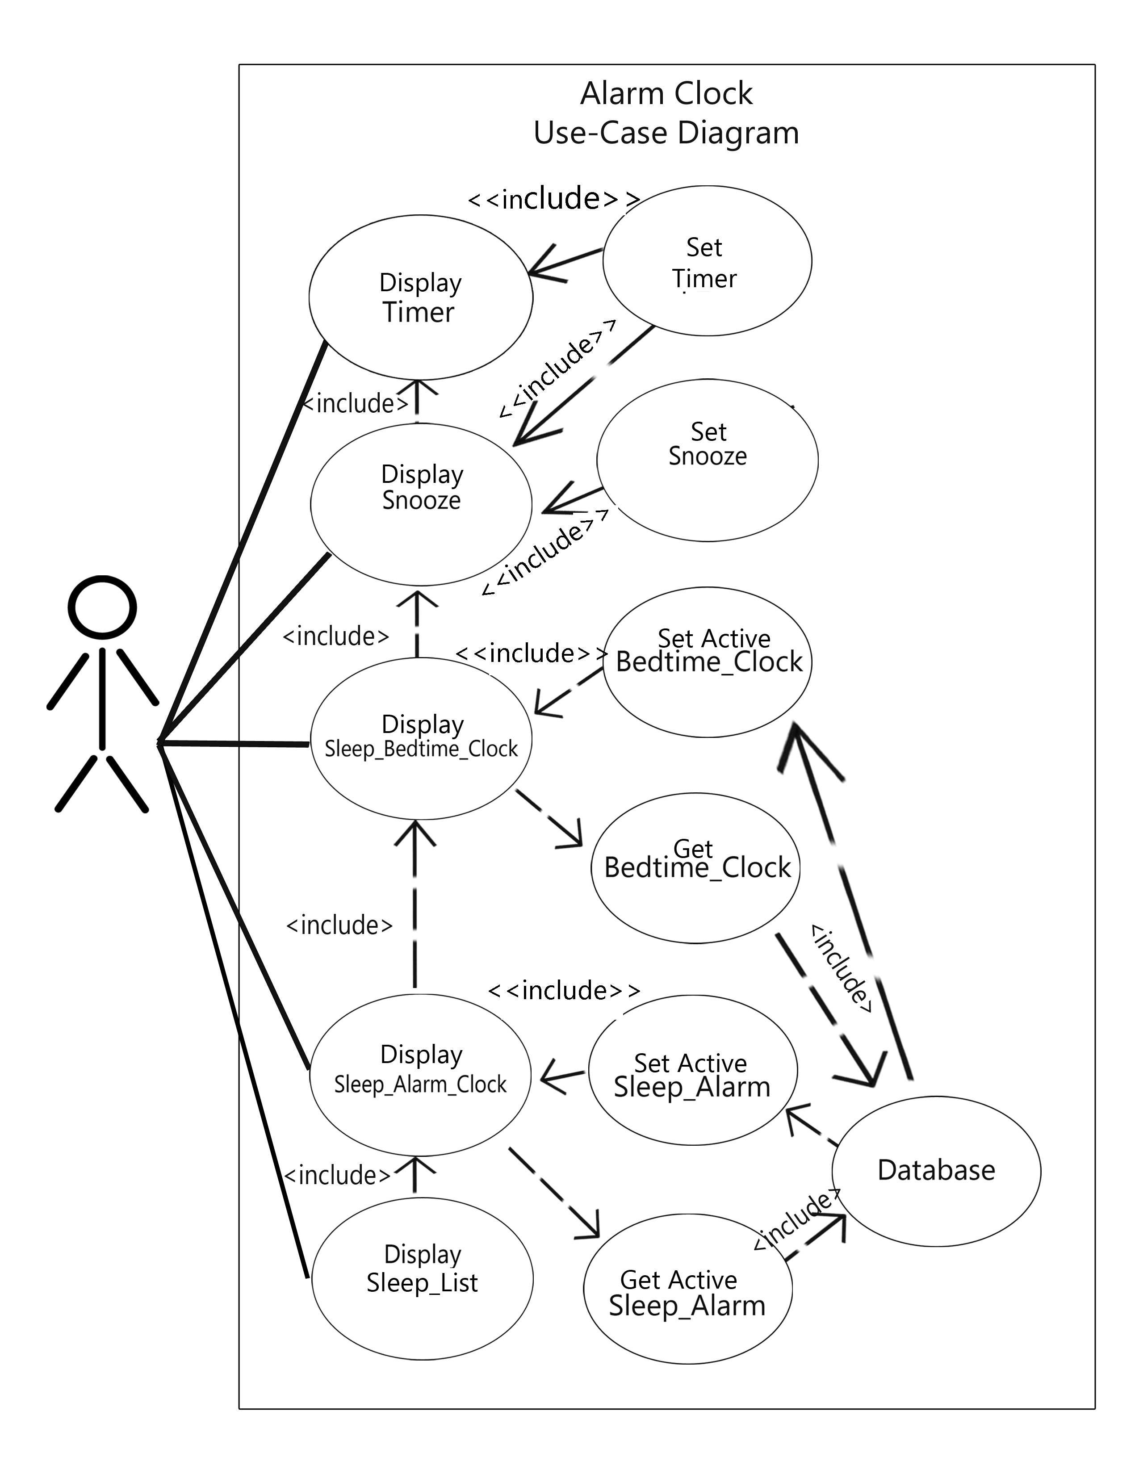
Use Case Diagram

Slide 12

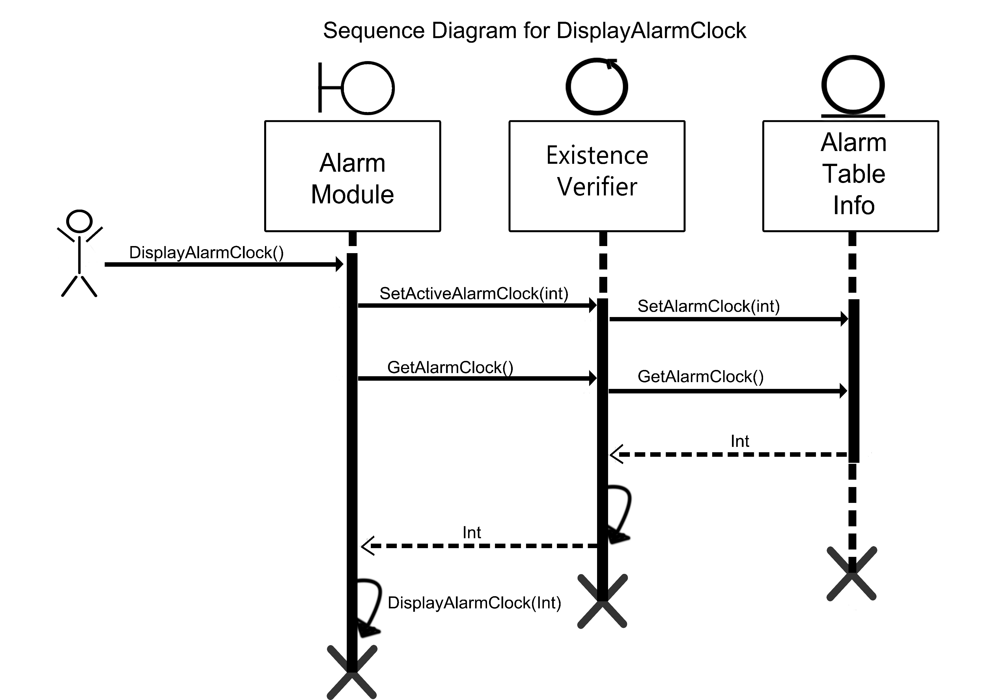
Sequence Diagrams

Slide 13
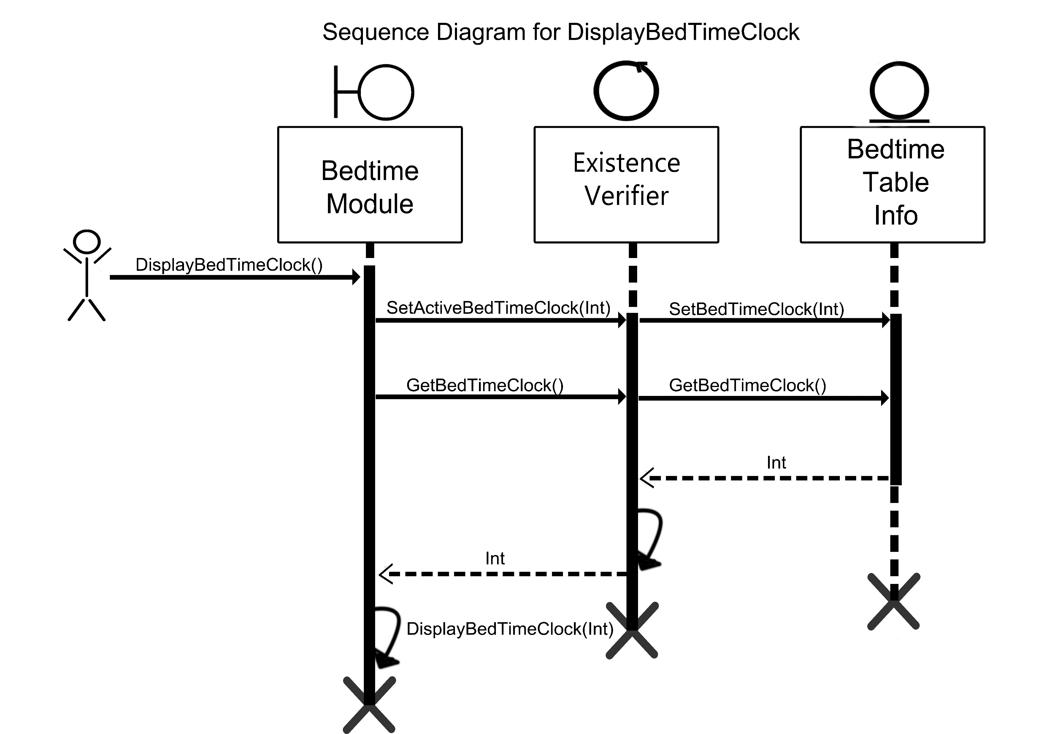

Slide 14
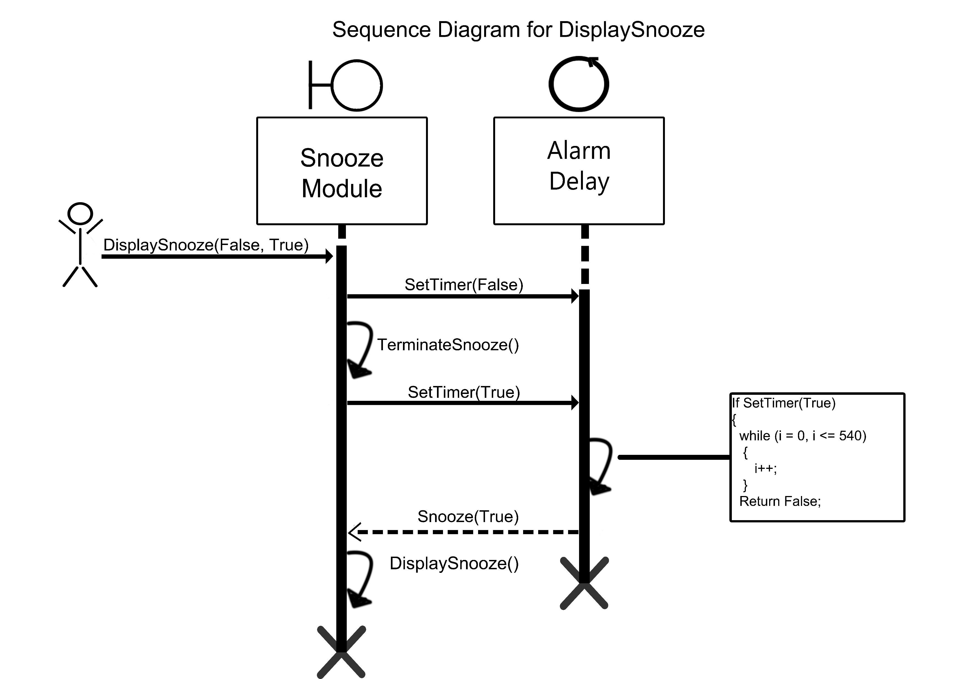

Slide 15
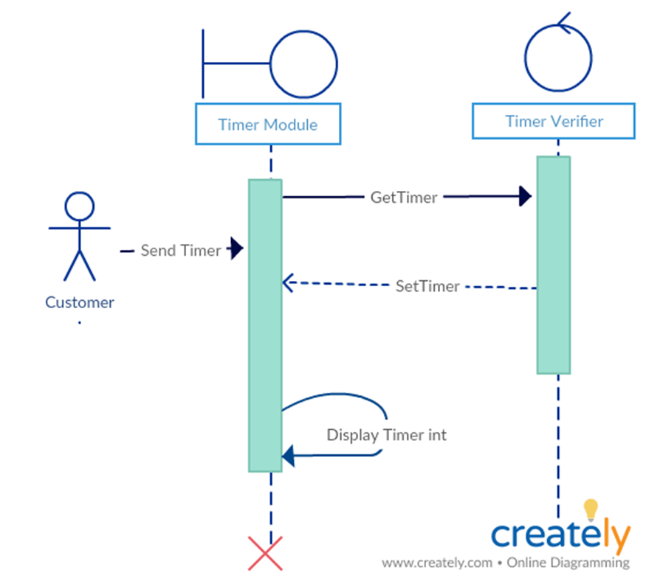

Slide 16
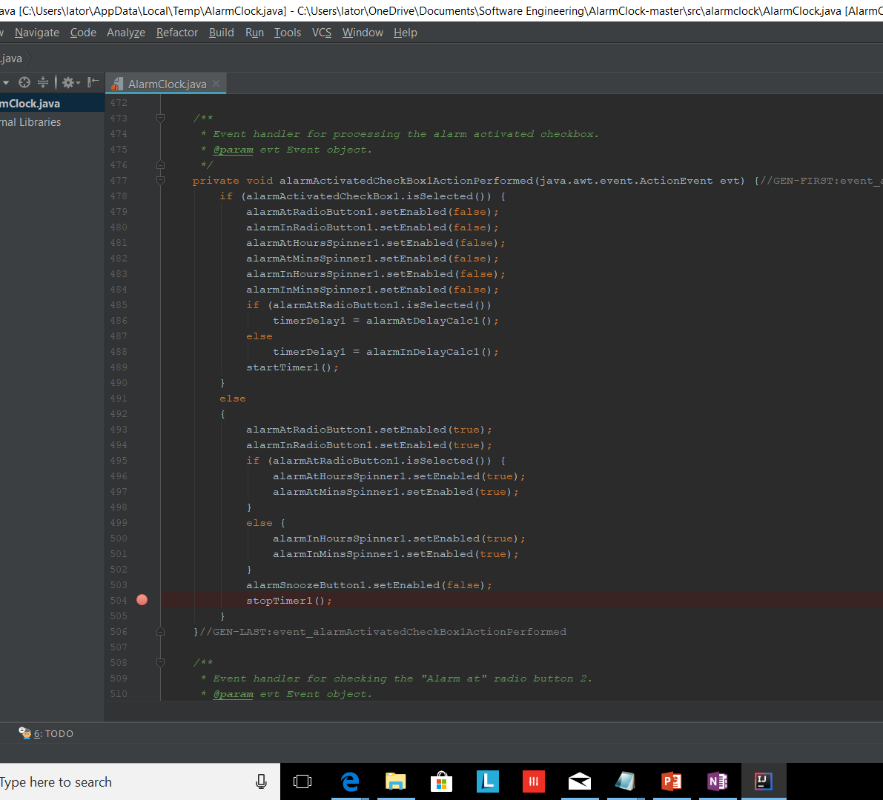
Source Code

Slide 17
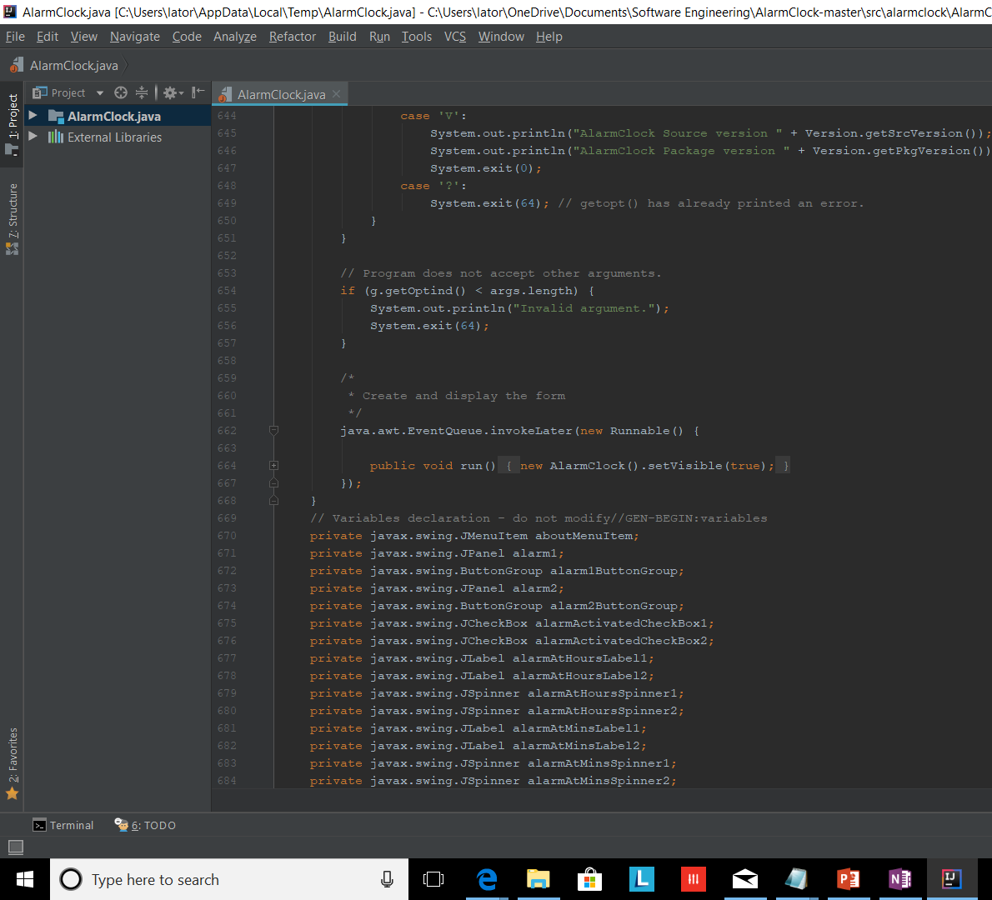
Source COde

